Slide 1
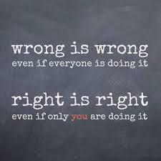
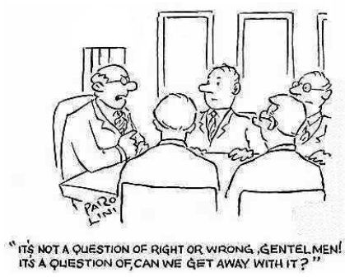

Slide 2
Computer Ethics Computer Technology 1
By Jill Einerson

Slide 3
Ethics Issues in Computing

Slide 4
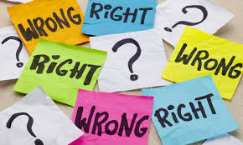
What are ethics?
Used to determine the “right” and “wrong” thing to do
What you “should” do in a certain situation
Pair Share: Is this ethical? Why or Why Not? (Scenario #2 from your assignment)

Slide 5
Why are ethics important in computing?
Information stored in computers can be valuable and private
We generate information and often misuse it.
A new branch of ethics called computer ethics
Computer users need to know what is expected of them

Slide 6
3 Categories of Ethics
Professional Ethics
Professional ethics are needed in the workplace
Policies don’t cover all possible situations
A sense of what is moral is needed to apply ethics to various situations

Slide 7
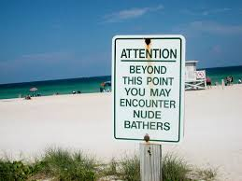
3 Categories of Ethics
Social Ethics
Defined by society and its existing primary values
Pair Share: What values existing in Utah might be different in another state? How about the U.S. vs another country?

Slide 8
3 Categories of Ethics
Individual
Defined by personal heritage
Family values
How you were raised can heavily influence your decisions

Slide 9
The Law

Slide 10
Are Ethics the Same as Laws?
Obey the principle behind the law, not just the law itself
Do you speed when you drive? Why or why not?
Laws are external rules that are punishable
Ethics are based on principles and values
No global punishment for being unethical

Slide 11
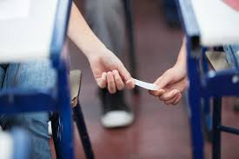
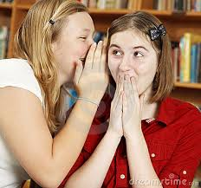
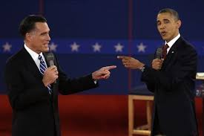
Defamation
What is libel?
What is slander?
A written statement or picture intended to damage someone’s reputation
Tort (civil wrong)
Consequences = lawsuit
An oral statement intended to damage someone’s reputation
Tort (civil wrong)
Consequences = lawsuit

Slide 12
Copyright

Slide 13
What is the copyright law?
Based on ethical principles, but is punishable!
Gives rights to the author of a work
Copying, reselling, leasing, lending, renting, distributing
Publicly displaying or performing
Transferring the copyright to someone else
Copyright Protection – any software or data from a computer is copyrighted as soon as it is in a tangible form.
Tangible form = means it is recorded somehow
Software cannot be legally copied without permission.

Slide 14
Software Licensing

Slide 15
5 Types of Software Licensing
You buy permission to use the software, not the software itself.
Public Domain
Freeware
Shareware
Open Source
All Rights Reserved

Slide 16
Public Domain
Not protected by copyright law
Created with public funds
Can be unreliable
Usually poor quality and has viruses
Copyrights can expire and become public domain especially in books and music

Slide 17
Freeware
Some examples are:
Protected by copyright
May be copied and distributed free of charge
Still under owner’s control
Cannot sale or modify without permission

Slide 18
Shareware
Free for a limited time
Can charge a fee for permanent use
May turn itself off after a period of time (30 day trial)
Some features are not available unless you purchase or upgrade

Slide 19
Open Source
Some examples are:
Linux, Gimp, OpenOffice, Firefox
Free software
Source code is available or “free” for anyone to modify
Can add functionality and features to software
Can resell it
Most commercial products have an open source competitor

Slide 20
All Rights Reserved
Some examples are:
Windows, Quickbooks, Adobe
Protected by copyright laws
Only for use by purchasers
Must have owner’s permission to use it

Slide 21
Software Piracy
Software piracy is the illegal
copying of software
Estimated $39 billion/year lost globally
First offense = $250,000 and 5 years in jail
$ loss to publishers result in higher cost to consumers
If my friend is pirating software, why should I care? He’ll be the one who gets in trouble, right?

Slide 22
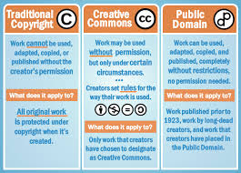
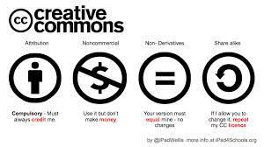
Creative Commons Software License
A public copyright license that enables free distribution of a copyrighted work
Gives users the right to share, use and add to a created work
This license protects the people who use or redistribute the author’s work

Slide 23
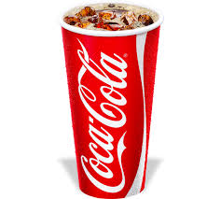
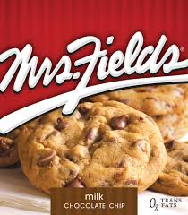
InteIntellectual Property
Exclusive rights are recognized for creations of the mind such as:
Inventions
Discoveries
Designs
Some common types of Intellectual rights include: copyright, trademarks, patents, trade dress and trade secrets
Trademark - is a word or symbol that indicates ownership and is used exclusively by the owner
Notes:
Trade Secrets are the process, formulas, recipes used to create a product that gives an advantage in the market. Ex. Coke’s recipe, Mrs. Field’s Cookie Recipe, Google’s Search algorithm
Trade dress is the total image or overall appearance of a product ready to go to market. Ex. Heinz ketchup bottle shape and label
Trademarks are brands

Slide 24
Plagiarism

Slide 25
What is plagiarism?
Plagiarism is the unlawful use of another’s ideas or words
Give proper credit to the author for the material you use
Pair Share: What is the difference between paraphrasing and quoting?
To be safe, always cite the source even when no copyright symbol is evident!
Plagiarism is fraud. Accidental plagiarism is negligence. Both are unethical and illegal!

Slide 26
Privacy

Slide 27
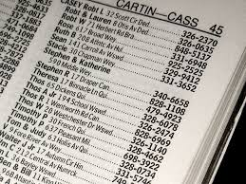
Public vs. Private Information
Public
Private
Can be used without your permission
Name
Address
Courses at School
Debts You Owe
Police Report Involvement
Cannot be used without owner’s permission
Medical Records
Grades
Social Security #
Tax Returns

Slide 28
E-Mail

Slide 29
Abuse of E-mail
Inappropriate
Illegal
Spamming – unsolicited mail sent to promote a product or service
Flaming- unkind messages to discourage more spam
Trolling- messages designed to provoke anger or fights
Phishing- pretending to be a trustworthy business to obtain personal information
Nuisance – messages that continue after the recipient asks that they stop
Harassment- messages that are threatening or intimidating

Slide 30
Acceptable Use Policy (AUP)
AUP – outlines what is acceptable or prohibited by computer users.
Legal documents that should be understood and followed
Guidelines for:
Personal computer files and documents
Personal and private information
Ethical conduct

Slide 31
References
Google Images
Wikipedia

