Slide 1
Computer History
Computer Technology

Slide 2
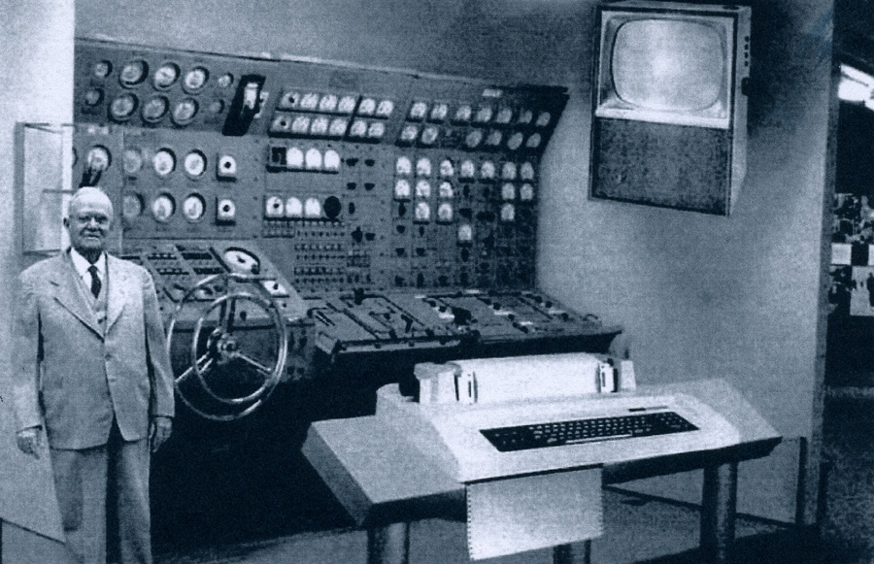
What did your grandparents think a home computer would look like?
In the late 1950’s, Popular Mechanics Magazine designed “the home computer” of the future (around the year 2000).
This is what they thought it would look like.

Slide 3
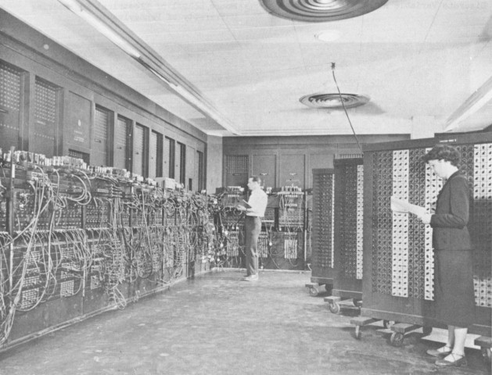
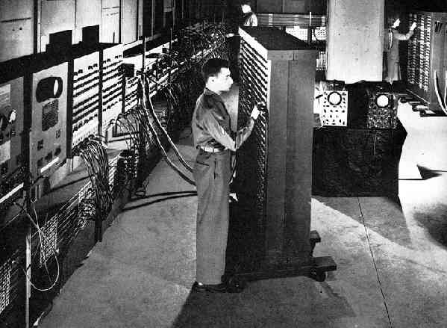
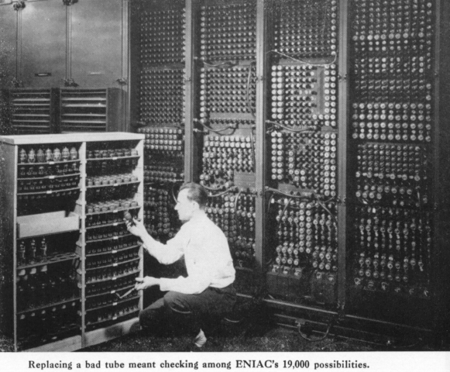
The First Computer
Vacuum tube computer created in 1946
Called the ENIAC

Slide 4
History of computers 1946-1964
Year | Important Point in History
1946 | ENIAC—First vacuum tube computer is completed.
1950 | US Census Bureau completes the 1950’s census on the UNIVAC 1 computer.
1958 | Integrated Circuit is invented.
1960 | The minicomputer is introduced by DEC
1964 | IBM enters the computer industry by introducing its System 360 computers.

Slide 5
DEC Minicomputer

Slide 6
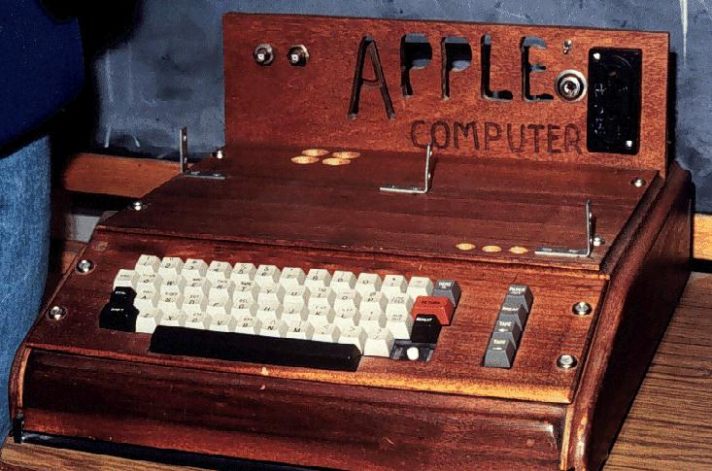
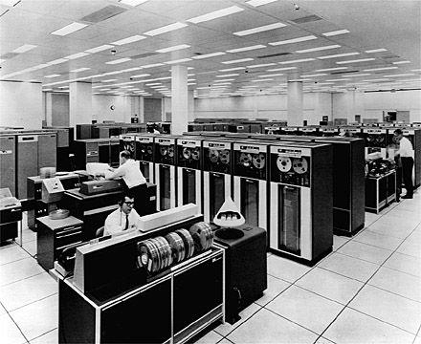
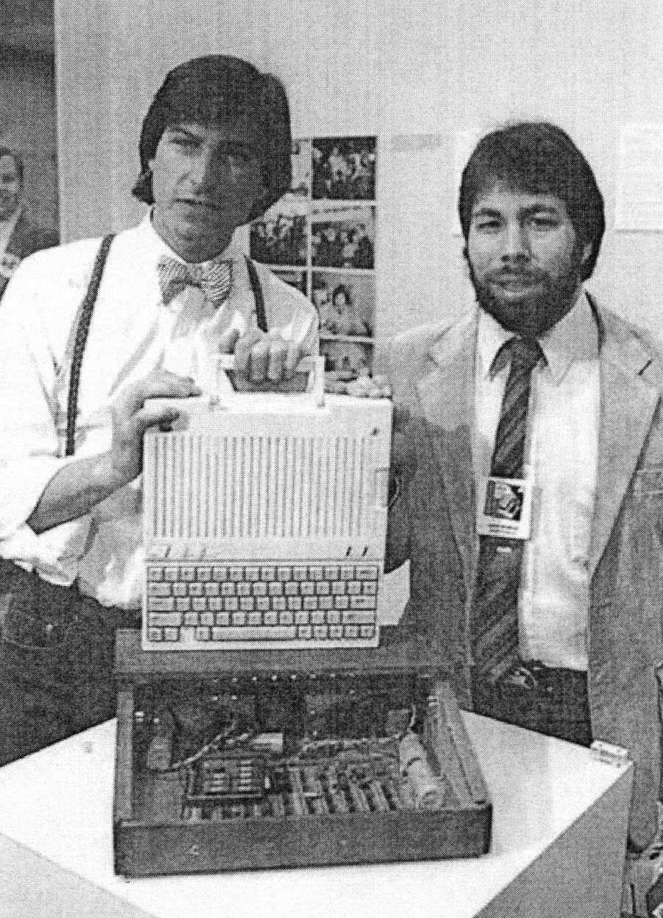
Great Moments in computer History for the 1970s.
Can you guess what these photos represent?

Slide 7
History of computers 1970s
Year | Important Point in History
1971 | Intel creates the first microprocessor.
1972 | Personal computing is born when Intel creates their 8008 microprocessor.
1976 | Jobs and Wazinak create the Apple 1 computer. The first supercomputer is also introduced.

Slide 8
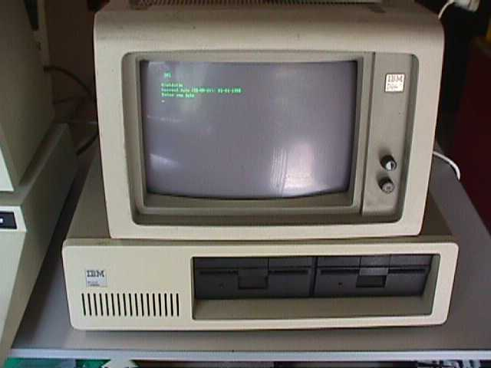
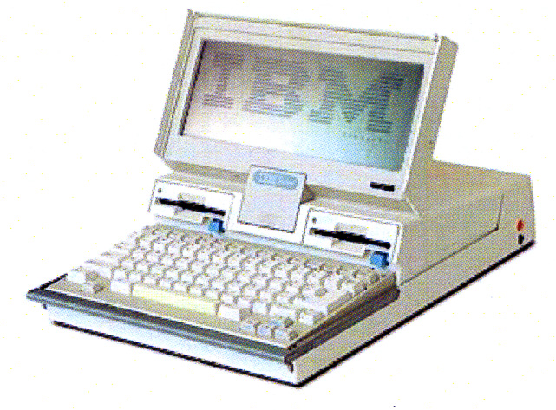
Great Moments in computer History for the 1980s.
Can you guess what these photos represent?

Slide 9
History of computers 1980s
Year | Important Point in History
1981 | IBM introduces its personal computer,
1986 | IBM introduces the first laptop. It weighed 12 pounds and the cost was $1995.

Slide 10
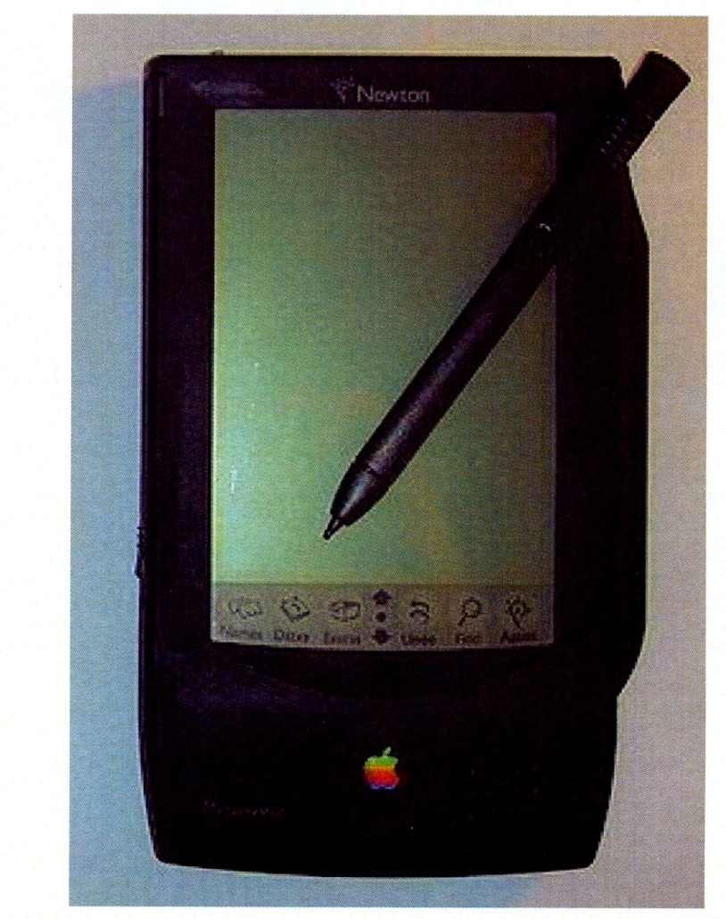
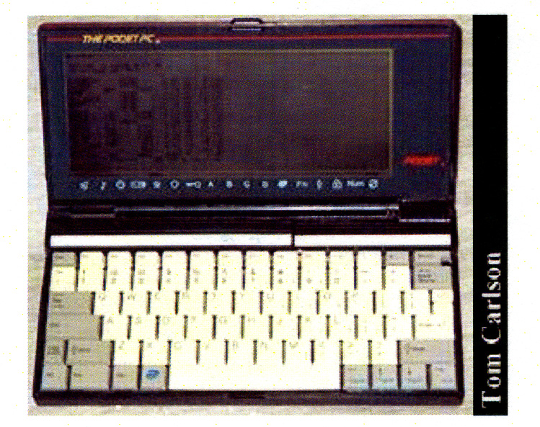
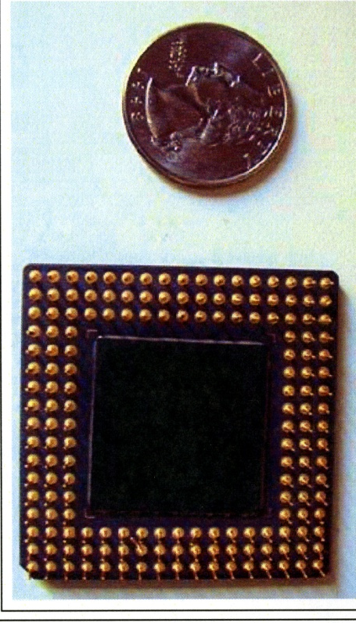
Great Moments in computer History for the 1990s.
Can you guess what these photos represent?

Slide 11
History of computers 1990s
Year | Important Point in History
1990 | Pocket Computers are introduced by the Poqet PC company.
1993 | Apple releases the first PDA, the Message Pad
1993 | Intel releases the Pentium processor.

Slide 12
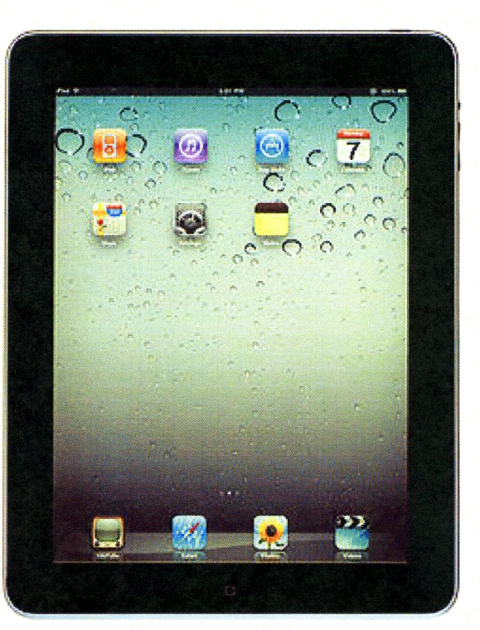
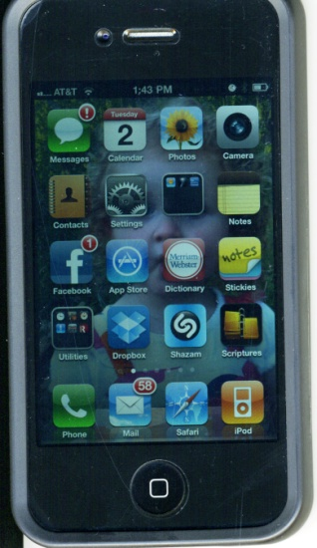
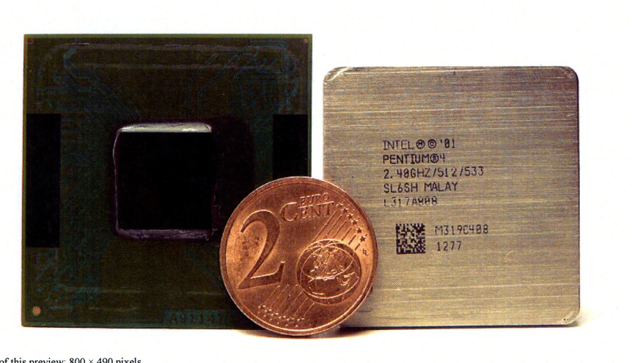
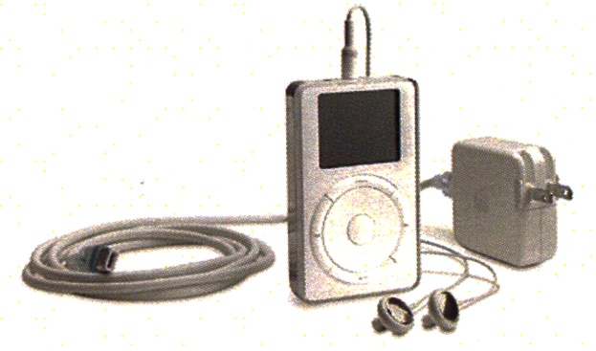
Great Moments in computer History for the 2000s.
Can you guess what these photos represent?

Slide 13
History of computers 2000s
Year | Important Point in History
2000 | Intel develops the Pentium 4 processor.
2001 | Apple introduces the iPod.
2002 | 1 billion PC’s are shipped worldwide since 1970’s.
2003 | MySpace founded. (It was the most popular social networking site until 2007.)
2004 | Facebook founded. (As of 2011, it had 750 million users.)
2005 | YouTube founded. (Google purchases it in 2007 for $1.6 billion)
2006 | Intel releases the CORE 2 Duo processor. Sony creates BluRay Technology. Twitter is launched.
2007 | Apple introduces the iPhone.
2009 | Intel releases the Xeon processor.
2010 | Apple introduces the iPad.

Slide 14
Types of Computers
PC’s, Minicomputers, Mainframes, Supercomputers

Slide 15
Four Types of Computers (In order of size and Power!)
 | Size | Instructions Executed Per Second | Number of Users | Price Range
Personal Computer | Fits in hand or on a desktop. | 500 million + | A single user or part of a network | $100-$1,000
Minicomputer | About the size of a file cabinet. | Millions | Hundreds of users at the same time. | $1,000-$10,000 or more
Mainframe Computer | Occupies a full or partial room. | Millions | Hundreds of users at the same time. | $1,000,000
Supercomputer | Occupies a full room | Billions | Thousands of users at the same time. | $2,000,000 or more

Slide 16
Types of Personal Computers
Personal Computer
Capable of performing its own input, output, processing, and storage.
Four types of PC’s:
Desktops
Portable
(Laptops or Notebooks)
Tablet PC’s
Hand-Held
(PDA’s)
PDA—Personal Desk Assistant
Common examples of PDA’s are iPods or Phones
Tablet PC’s--Portable computers that can recognize handwriting on the screen.

Slide 17
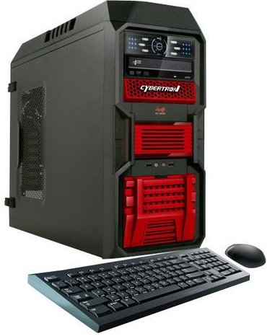
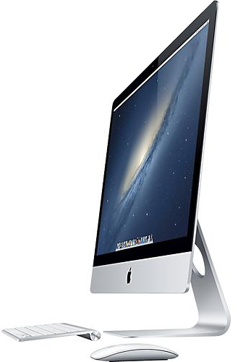
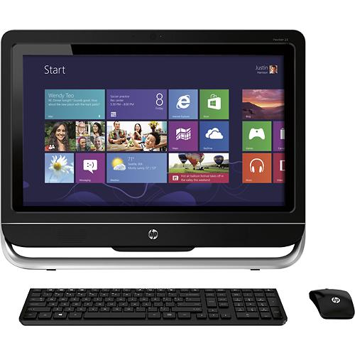
Desk Tops
PC
Stationary
Large storage capacity
Input/output devices
Requires key board, mouse and display device (monitor, projector)
All-In-Ones
Windows
Mac
Processor, hard drive and memory built into screen
Touch screen
Key board and mouse input

Slide 18
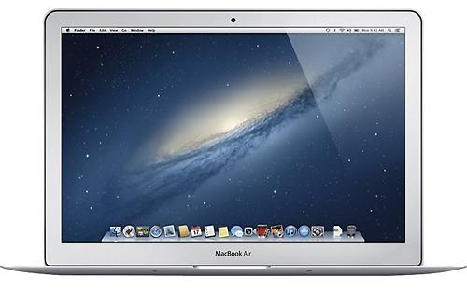
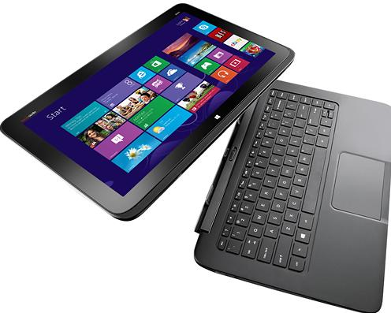
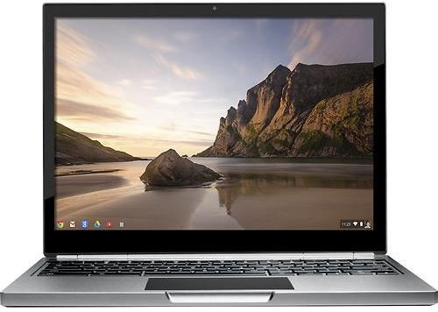
Laptops
PC, Mac, Google Chromebook
Convertible
Allows for input/output devices
Portable

Slide 19
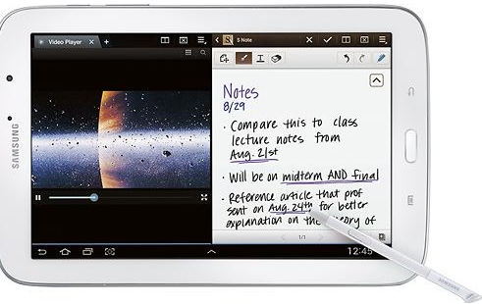
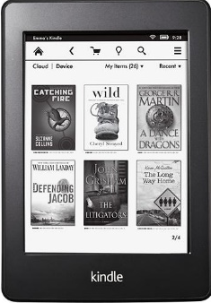
Tablets & E-Readers
Operating systems
Apple iOS, Android and Windows
Apps
Compact and Portable
Biometric interface (touchscreen)
Expandable memory
E-Ink
Black & white display
Easy to read outdoors
Uses less power than LCDs for longer battery life

Slide 20
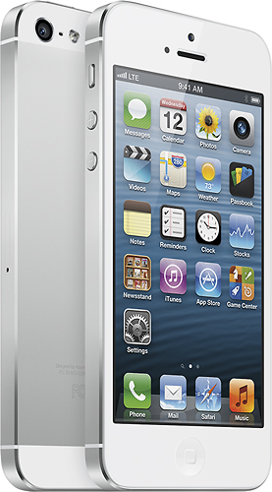
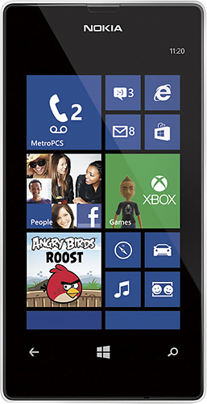
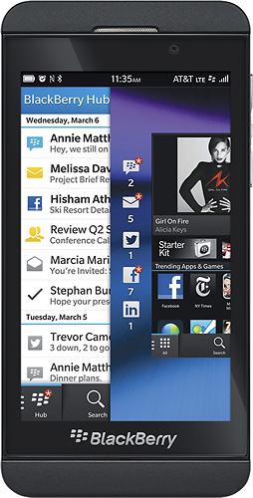
HandHelds: Mobile Phones
Apple – iOS
Windows
Android
BlackBerry
Expandable memory
Built in camera up to 12 megapixels

Slide 21
Computer Storage
External, Internal, Temporary (RAM), Permanent (ROM)

Slide 22
How Has Storage Changed through the Years?
As your instructor holds up the storage examples, summarize how computer storage has changed.
Cloud technology
How will cloud technology change storage now and in the future?

Slide 23
Classifying Storage
Internal
External
Memory
ROM (permanent memory)
Read Only Memory
Permanently stored on memory chips located inside the CPU.
This is not writable memory!
RAM (temporary memory)
Random Access Memory
Temporary memory in which the programs and data are stored while the computer is in use.
Holds program instructions until it can be sent to an output storage device.
This readable and writable memory.
Secondary Storage
An external way to store programs, data, and information.
Can be permanent storage.
Examples would be:
Floppy Disks
CD’s
DVD’s
Flash Drives

Slide 24
Measuring RAM
Kilobytes to Yottabytes!

Slide 25
What’s a BYTE?
A byte is one alphabetic letter, number, or special character.
RAM is measured in bytes.

Slide 26
Storage Capacity
Storage Capacity | Number of Bytes | Other Info
Kilobytes | 1000 bytes
Megabytes | 1 million bytes
Gigabytes | 1 billion bytes
Terabytes | 1 trillion bytes
Petabyte | Quadrillion bytes (1000 terabytes) | 1 petabyte = 20 million four-drawer filing cabinets filled with text. 1.5 petabytes = size of the 10 billion photos on Facebook.
Exabyte | Quintillion bytes (1 billion gigabytes) | One exabyte of hard drive storage in 2008 would have cost more than $200 million. To give you an idea of the size of this, a stack of CDs storing 295 exabytes of information would reach beyond the moon.

Slide 27
Storage Capacity (Continued)
Storage Capacity | Number of Bytes | Other Info
Zettabyte | Sextillion bytes (1 billion Gigabytes) | As of 2010, it is estimated that all of the combined space of all the computer hard drives in the world would equal one zettabyte.
Yottabyte | Septillion bytes | No computer as of 2010 has achieved this much storage space.

Slide 28
Trends
What Does the Future Hold?

Slide 29
Social Networking
In 2011, 63.7% of US internet users will use social networks on a regular basis, amounting to nearly 148 million people.
Future trends:
Social Networking becomes more of a feature on websites.
More marketing designed specifically for social networking sites.
Tight budgets will force more companies to turn to free social networking sites to build their businesses and client base.
Expect more websites to be “social” in context.
Users expect that if you're on a commerce site that you know your friends are also on, you can see what your friends bought there and if they liked it.
Websites that just have user content are out of date.
How we share is changing.
Social Discovery built into websites and social networking sites
Social Discovery—Allows people to discover on their own terms, when and where they want.
Google’s Social Search will change the way we interact with search engines by pushing relevant content from our personal networks to the front of search results
Web publishers putting modules on their sites that allow cross-site sharing.
More public communication rather than private communication. (“Like”)
Users over the age of 35 will continue to expand.
Mobile Sharing
More mobile apps for social networking.
The concept of a friend network will be a portable experience.
Real Time Dating Experiences

Slide 30
Hardware Trends
Smart phones
3-D Technology
Sharp has already announced two Android-based smart phones on which users will be able to play games and watch movies in 3D without the need of special glasses.
Increased use of NFC Technology
You will be able to make payments including buying tickets
NFC compatible window stickers, which allows users to touch their phones to the sticker and find out more about the business.
NFC technology can make credit card payments, serve as a keycard or ID card.
NFC can share a contact, photo, song, application, or videos.
Smaller, Faster, More Mobile
Currently, more than 50% of users are leaving their computer laptops at home and opting for more mobile, smaller devices.
One Device
Integration of all hardware on to one device.

Slide 31
Scent Technology
Entertainment platforms are looking into ways to combine viewing with scent type products.
Scent generators could release smells.
Artificial noses
Could capture and playback the smells in a digitized format
On the verge of becoming a commercial reality
Could be used in the food, beverage, home theater, medical, and environmental applications
So, next time a chef’s cooking a meal on TV, you know how it smells if not how it tastes.
Other uses
Codes
Researchers at UCLA have patented a project that would allow US Army officers to use coded smells to give orders.
These can be delivered silently, in the dark, and when loud noise is drowning out speech.
Odor Recorder
Engineers in Tokyo have developed an odor recorder that can analyze scents and reproduce them by combining the 96 chemicals packed inside the device.
-

Slide 32
Social Uses
No walls!
Attending parties, games, city hall, and courts through web cams
Increased use of students and workers meeting in multiple places

Slide 33
Medical uses
Use of computers/web cams to do medical exams at home.
Nanomedicine
Use of nanorobots to be injected into people’s blood streams to remove cancer cells, etc.

Slide 34
Denser, faster, More Powerful
Shrinking size, growing capabilities
Nano-engineered carbon tubes
Only 10 atoms in width
These can conduct an amount of information that is actually 50,000 times smaller than a human hair.
Current silicon chips are built at 1,000 times thinner than a human hair.
Portability
Computer jewelry
Expanded use of voice commands to operate computers
Artificial Intelligence
Smarter, More Capable robots and robotic devices

Slide 35
Storage
Cloud Technology
Less need for flash drives or external storage devices

Slide 36
References
www.computersciencelab.com
www.omnium-gatherum.org
www.wikipedia
www.newlaunches.com
http://question-marketing.com
http://gpuscience.com/hpc/the-exascale-supercomputer-of-2020
http://files.myopera.com
www.oldcomputer.net
http://www.netapp.com/us/

Slide 37
References continued
http://www.maverickdean.com/tamora/index.php/archive/scent-technology-leads-the-way/
http://www.nfc-forum.org/aboutnfc
www. cellphones.about.com/od/smartphonebasics/a/what_is_smart.htm -

