Slide 1
Graphics on the Web
Business Web Page Design
Standard 2 HTML

Slide 2
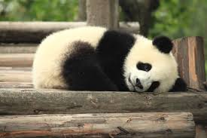
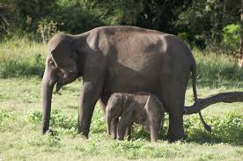
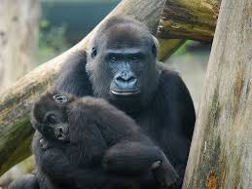
“A Picture is Worth 1000 Words”

Slide 3
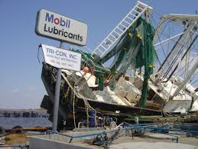
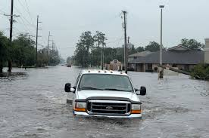
“A Picture is Worth 1000 Words”

Slide 4
“A Picture is Worth 1000 Words”

Slide 5
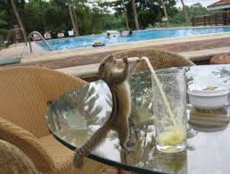
“A Picture is Worth 1000 Words”

Slide 6
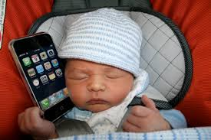
“A Picture is Worth 1000 Words”

Slide 7
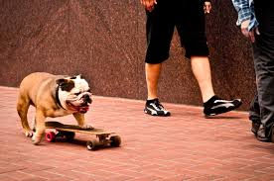
“A Picture is Worth 1000 Words”

Slide 8
Copyright Laws
Not all media on the Internet is free to use in your website
Copyright Laws prohibit the redistribution of many images found on the Internet
Creative Commons
Reusable material with rules
search.creativecommons.org
Notes:
You can’t just go to Google Images and use any image you find there. Search for public domain images, wikimedia, creative commons

Slide 9
File Formats for Graphics in the Web
GIF
JPEG
Graphics Interchange Format
.gif
Compresses information (reduces the file size)
Translates into binary code
Good for images with few colors
Loads all at once
Starts blurry then gets sharp
Joint Photographic Expert Group
.jpg, .jpeg, .jpe
Compresses information (reduces the file size)
Good for photographs with many colors
Notes:
PNG is also an acceptable format for web graphics. It is newer than GIF and JPEG, supported by most newer browsers.

Slide 10
Points to Consider
Not all images look great or load quickly on different computers and devices
Keep the total file size of all images on the web to less than 100k (per image)
Limit graphic dimensions to 480 px wide to 300 px high to avoid forcing users to scroll
Use links to display large numbers of images
Only use images that add to the meaning of your site.
Notes:
Consider these points when adding images to your website. Only place images when and where they will add meaning to your site.

