Slide 1
The Internet: Part 1
The Internet and Web Browsers
Created by Kelly Seale
Adapted by Jill Einerson

Slide 2
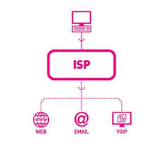
Internet Necessities
Internet Service Provider (ISP)
Comcast
CenturyLink
Utopia
Web Browser
Internet Explorer
Mozilla Firefox
Google Chrome
Search Engine
Google
Yahoo

Slide 3
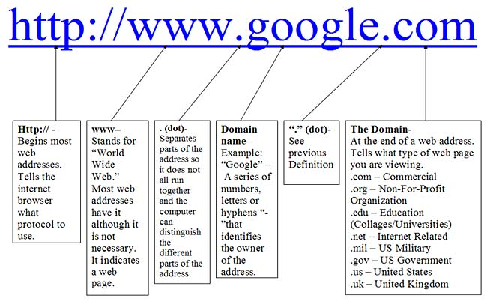
URL
Uniform Resource Locator
Identifies Internet locations
http://www.microsoft.com
Protocol
Host name or server
Folder name
File name

Slide 4
Domains
.com (commercial)
.edu (colleges)
.gov (government)
.net (networking)
.org (non profit)
.mil (military)

Slide 5
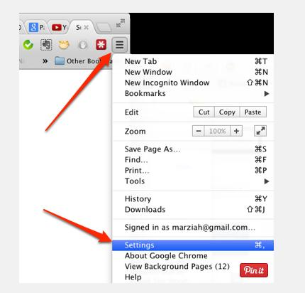
Cookies
An Internet cookie is a piece of data placed on your machine by a Web server. Your computer uses cookies to save and retrieve information like when you fill out a form on the Internet with your name, address and other information. Some cookies store passwords to restricted sites and track user browsing habits. Cookies only keep track of data you provide. They cannot search your hard drive to gather additional personal data. Many retailers and search engines use cookies to track your purchasing preferences for marketing purposes.
To delete cookies:
Click Settings Advanced Settings
Clear Browsing Data, All Cookies
Notes:
Cookies can keep you logged in to favorite websites, keep track of your shopping cart. But maybe you don’t like the idea of being followed so you disable your cookies.

Slide 6
Secured Site
Two indications that ensure confidential data
https protocol on URL address
security button (padlock icon) on browser

Slide 7
Web Browser
A Web browser is:
A tool for travelling the Internet
A multimedia interface allowing integration of text, graphics, audio and video.
Chrome (68% in 2015)*
Mozilla Firefox (19.1%)
Internet Explorer (6.3%)
Safari (3.7%)
* source: www.w3schools.com
Notes:
As of March 2015, Chrome was the most widely used browser in the US. Follwed by Internet Explorer (IE), Safari, then Firefox

Slide 8
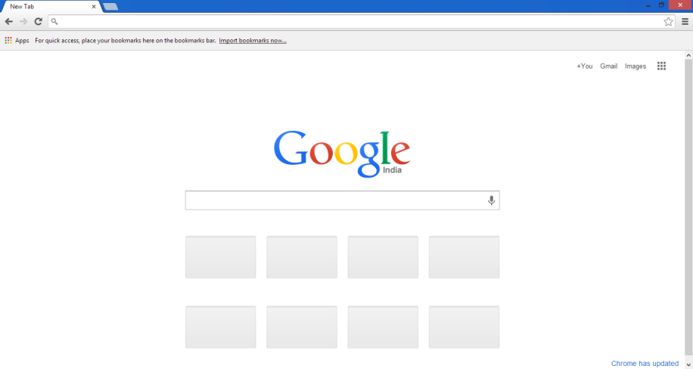
Google Chrome

Slide 9
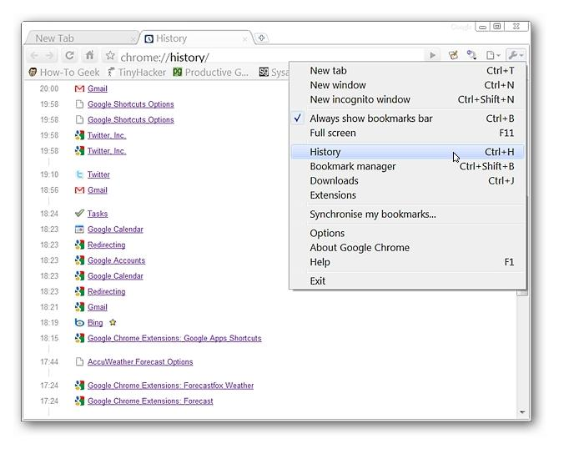
History Feature
Displays all recently visited URLs
Use to help you to return to previously viewed web pages
Access it by Ctrl+H (in most browsers)
Notes:
Can access history by using CTRL + H or using the Tool Menu and select History.

Slide 10
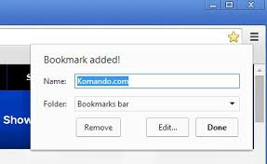
Bookmarks or Favorites
Save links to useful resources
Create your own custom menus
CTRL + Shift + B to see bookmarks bar
Click the star to add a bookmark
Drag a link to the bookmark bar
Ctrl+D (in most browsers)
Notes:
Might be known as “Favorites” in other browsers.
CTRL + Shift + B to see Bookmarks bar. To add a favorite click the star in the far right or drag a link to the bookmarks bar.

Slide 11
Tabbed Browsing
Allows more than one web page to open within the same browser window.
Each window appears on a separate tab
Use to organize web pages while browsing

Slide 12
References
This presentation was created by Kelly Seale of Nebo School District
www.google.com

Slide 13
The Internet: Part 2
Searching the Web Effectively

Slide 14
What is a Search Engine?
Search Engine – indexes information in Web pages to present you with a list of relevant Web pages when you run a search. Search engines send Web crawlers or spiders out to the World Wide Web to read the contents of Web pages. Examples: Google, Yahoo, Bing and Ask
Notes:
A search engine is different than a web browser. Web browsers allow you to access the internet. Search Engines are programs that search the web for keywords that you query about.

Slide 15
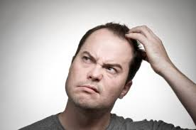
Searching the Web Effectively
What have you “googled”
today?
Fact: Google is the world’s most popular search engine
Google facilitates over eight billion searches each day

Slide 16
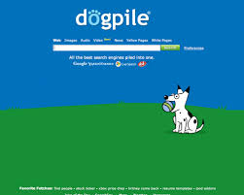
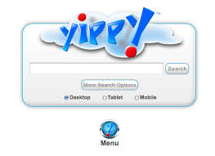
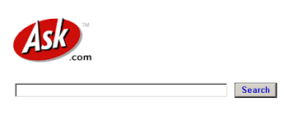
Other Search Engines
Bing
Yahoo
Ask
Dogpile
Yippy
Notes:
Google is not the only search engine available

Slide 17
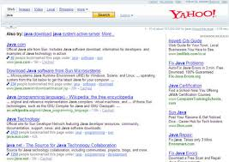
How do search engines differ?
Unique formulas called algorithms
Different ranking strategies
Which sites are searched
Some search the entire web for results
Specialty search engines (dailystocks.com)
Only search sites that are relevant
Metasearch engines
Search other search engines
Example: www.dogpile.com
Notes:
You don’t get the same results from every search engine. They use different algorithms (formulas) to search and create results. Search engines rank results differently like how frequently that word or phrase is searched for or used in a particular site. Google and Bing search nearly the entire web, but some search engines only search relevant sites. Some search engines are considered “specialty” like dailystocks.com which is used primarily by investors.

Slide 18
Strategies for Searching
Try a variety of search engines, not just Google
Use Advanced Search form
Use Keywords and Phrases
Related to your subject
Consider other meanings
Use Boolean Operators (AND+,(..), OR, NOT -, “”)
Ex: “sand sharks”
https://www.commoncraft.com/video/web-search-strategies
Notes:
Boolean operators can help refine a search, but today most search engines have an “Advanced Search” page that allows you to refine your search using a form. Metasearch engines don’t just search websites, but they search other search engines for results.

Slide 19
Safety Reminders
Pair / Share: Turn to a neighbor. You will be given 2 minutes to read #1-10 Safety Reminders and guess what the answers should be. We will then discuss them as a class.
Notes:
Never give any __personal information__________ to anyone you meet online. Birthday, Work Schedule
Never meet up with anyone you don’t already know.
Don’t fill out any “fun” questionnaires that are forwarded to you, even if they’re from your friends. Remember anything can get __forwarded__________.
Make sure you know everyone on your buddy or contact lists. If you haven’t met the people face-to-face, they may not be who they __pretend to be______.
You do not have to answer e-mails or texts from people you don’t know. In fact, don’t!
There is no such thing as “__private______” on the Internet!
Be careful about posting pictures of yourself. Pictures with identifiers like where you go to school or where you work can act as shopping lists for ___predators______.
Don’t send pictures of other people. Forwarding an embarrassing picture of someone else is a form of __bullying________.
Don’t download content without your parent’s permission. Many sites have __spyware_____ that will damage your computer or inappropriate content that can damage your __mind ____.
Never share your password with anyone but your parents.

Slide 20
The Internet: Part 3
Security and Privacy on the Internet

Slide 21
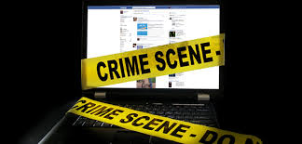
Computer Crime
Computer Fraud – Use of a computer or computer data for dishonest purposes
Hacking – Invading someone else’s computer or its data for malicious intent or personal gain
Spyware- Software that is installed secretly to take partial control over the user’s interactions on the computer without the user’s consent
Phishing- attempting to acquire sensitive information (passwords, account #s etc.) by masquerading as a trustworthy entity by electronic communication (e-mail, text, etc.)
Viruses – Cause corruption of data or hardware on a computer.

Slide 22
Types of Viruses
Worms – designed to overwrite operating system memory space on the hard drive. Worms spread on their own via file transport methods like e-mail.
Time Bombs – a virus written to do something malicious at a specific date or time
Notes:
Worms spread on their own without human interaction. Time Bombs – The Michaelangelo virus was a famous time bomb set to trigger every year on March 6, which is Michaelangelo’s birthday

Slide 23
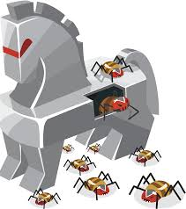
Types of Viruses
Trojan Horse- A virus that is spread by embedding the virus in another file. This allows someone else to access your computer without your knowledge.
Logic Bombs- A virus that makes the computer do something that is theoretically impossible such as dividing by 0.

Slide 24
Types of Viruses
Macro Virus- A virus that is embedded inside a macro. Once the macro is enabled, the virus begins.
File Virus- A virus that targets a specific file.
Notes:
A macro is a short series of commands that automates a repetitive task (such as opening a file) The Melissa Virus in 1999 caused problems world wide. Anyone that opened an infected document on the victims computer would have the virus sent, by itself, to the first 50 people in the e-mail address book on the infected computer. You may not even know it has happened. So don’t open attachments from people you aren’t expecting or know.

Slide 25
Types of Viruses
Attachments- Viruses are passed by opening attachments on e-mail while using the Internet
Boot Sector Virus- a virus that targets the boot sector of your hard drive. It makes it so you can’t boot up your computer.
Notes:
So don’t open attachments from people you aren’t expecting or know. Boot sector viruses are often transmitted by a flash drive that was left in the USB. When you start the computer with the flash drive still plugged in, the computer tries to launch a boot up record from the flash drive, which can trigger the virus to infect the hard drive. So take those flash drives out before booting up a computer!

Slide 26
Ways to Protect Against Viruses

Slide 27
Anti-Virus Software
For Purchase:
Free to download:
Norton Anti-Virus - $79.99/year
McAfee - $24.99/year
Kaspersky - $39.99/yr
Microsoft Security
Essentials (MSE)
Avast!
AVG Free

Slide 28
E-mail Attachments Cautions
Don’t open attachments or e-mail that aren’t familiar to you.
Save the attachments to a disk then scan the disk for viruses

Slide 29
Patches
A patch is a piece of software designed to fix problems with, or update a computer program .
Patches are useful because they often address new viruses or security issues that are known by the software company.

Slide 30
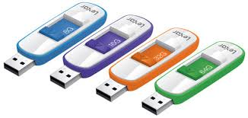
Safe External Devices
Scan all disks (storage devices) before allowing them to be read by your computer.

Slide 31
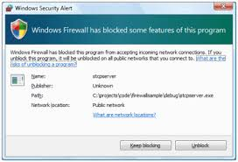
Firewall
A firewall is software that inspects network traffic passing through it. It denies or permits passage based on a set of rules.
A firewall can prevent network intrusion into a private network.

Slide 32
Privacy Issues
Ways to protect your data

Slide 33
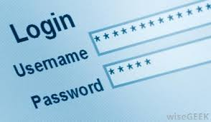
What is the best way to protect your data?
Control access to the data. Use a password!
For tips on creating a strong password, visit http://windows.microsoft.com/en-us/windows-vista/tips-for-creating-a-strong-password

Slide 34
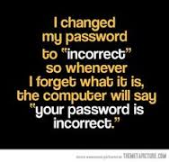

Slide 35
Is E-mail Private?
Email on the Internet is NOT considered to be private.
It would be hard to regulate
Employers pay for the software and your time while working.
Courts have ruled that it is not private.
Yes, employers can access your email at work
You can be fired for bad e-mail conduct while at work.

Slide 36
What can spyware do?
Spyware can do the following:
Track personal information
Change computer settings
Redirect you to websites that have viruses

Slide 37
What is a filter?
Software designed to control what content is permitted to the reader
It is used to restrict material delivered over the web.

Slide 38
Evaluating a Web Site
Not all information found on the Internet is accurate or reliable.
Consider the following:
Authority
Content
Frequency
Purpose
Design/Format

Slide 39
Social Media and Privacy Issues
Pair Share
Instructions: With a partner, discuss section 6 of your notes. Fill in the blanks with the answers you think are correct. In about 2 minutes, we will discuss them as a class.

