Slide 1
The Internet & Web Browsers
Business Webpage Design
Created by Kelly Seale
Adapted by Jill Einerson

Slide 2
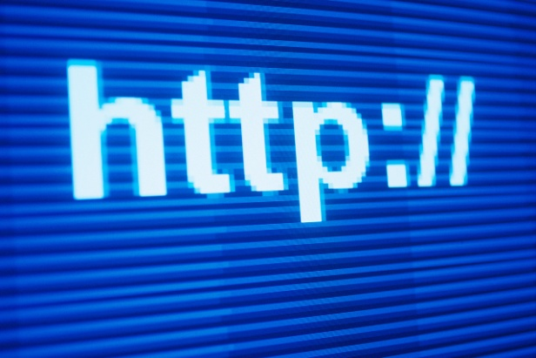
What is the Internet?
A global network connecting millions of computers
http://www.youtube.com/watch?v=7_LPdttKXPc
Notes:
To share research

Slide 3
History of the Internet
Started in 1969 by U.S. Defense Dept.
http://www.mediabistro.com/alltwitter/files/2013/06/Internet-then-and-now-james-final.jpg
http://dailyinfographic.com/wp-content/uploads/2013/01/history-of-the-internet.jpg

Slide 4
Definitions
  World Wide Web (WWW) – A system of internet servers that support HTML formatting.
  IP Address – A unique series of numbers assigned to every computer network in the internet EX: 168.28.233.11
  Domain Name – A text based equivalent for one or more IP addresses
  HTML – Hypertext markup language; coding language telling browsers how to display documents

Slide 5

Purposes of a Web Site
E-Commerce
Personal Use
Information Source

Slide 6

Purposes of a Web Site
E-Commerce
Conduct business
Sell products and services online
  Amazon.com
  Ebay.com
Communicate with other businesses & customers

Slide 7
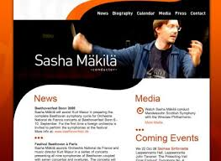
Purposes of a Web Site
Personal Use
Marketing self with personal portfolio
Stay in touch with social media
Send and receive e-mail
Fun/entertainment

Slide 8
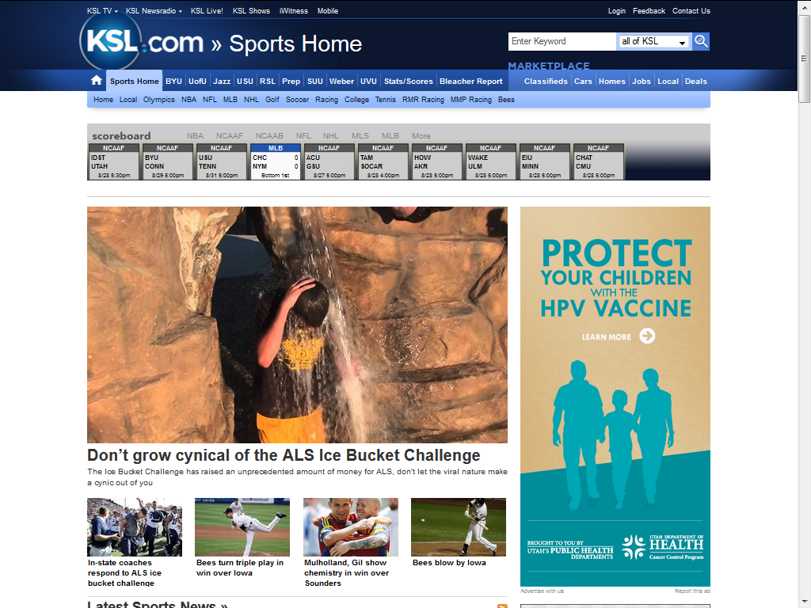
Purposes of a Web Site
Information Source
Non-profit organizations
Weather
News

Slide 9
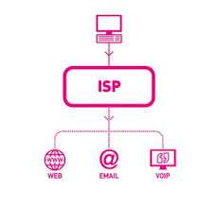
Internet Necessities
Internet Service Provider (ISP)
  Comcast
  CenturyLink
  Utopia
Web Browser
  Internet Explorer
  Mozilla Firefox
  Google Chrome
Search Engine
  Google
  Yahoo

Slide 10

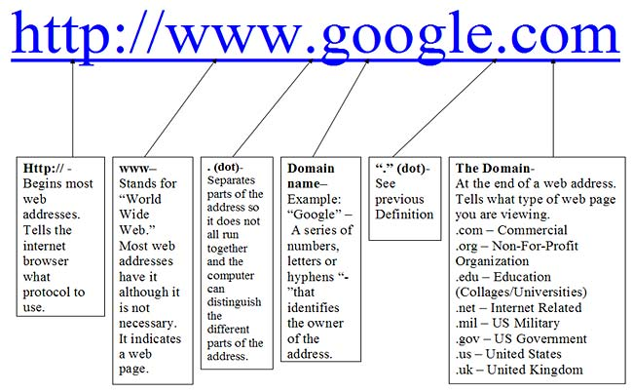
URL
Uniform Resource Locator
Identifies Internet locations
http://www.microsoft.com
  Protocol
  Host name
  Folder name
  File name

Slide 11
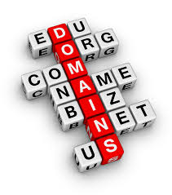
Domains
.com
.edu
.gov
.net
.org

Slide 12
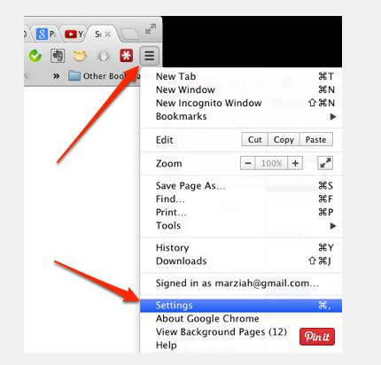

Cookies
Used by Web servers to differentiate users and to maintain data related to the user during navigation
To delete cookies:
    Click Settings Advanced Settings
    Clear Browsing Data, All Cookies
Notes:
Cookies can keep you logged in to favorite websites, keep track of your shopping cart. But maybe you don’t like the idea of being followed so you disable your cookies.

Slide 13

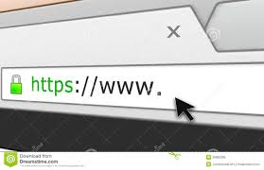
Secured Site
Two indications that ensure confidential data
  https protocol on URL address
  security button (padlock icon) on browser

Slide 14

Web Browser
A Web browser is:
  A tool for travelling the Internet
  Client software for viewing World Wide Web pages.
  A multimedia interface allowing integration of text, graphics, audio and video.
    Chrome
    Internet Explorer
    Safari
    Firefox
Notes:
As of March 2015, Chrome was the most widely used browser in the US. Follwed by Internet Explorer (IE), Safari, then Firefox

Slide 15
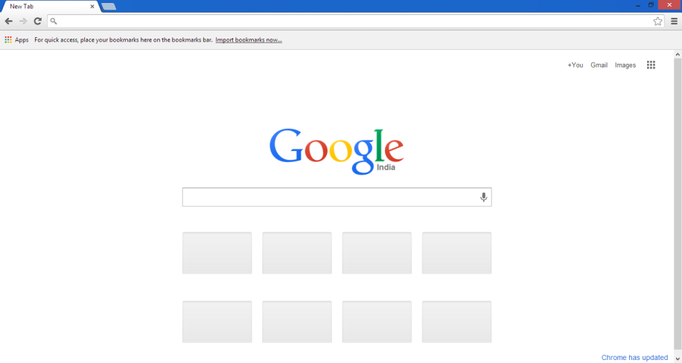
Google Chrome

Slide 16
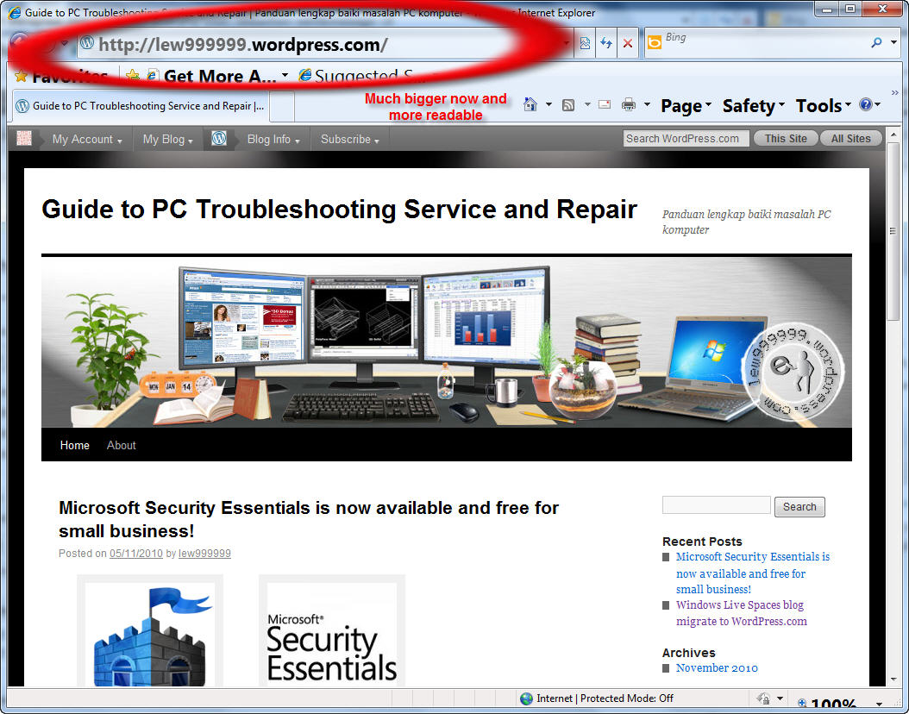
Address Bar
  Displays the URL address of the site you are viewing
  Allows you to go directly to a site on the Internet

Slide 17
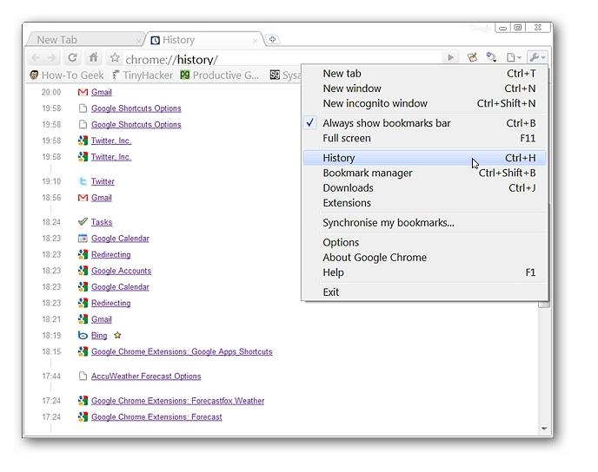
Using History in Chrome
Displays all recently visited web sites
Use to help you to return to previously viewed web pages
Notes:
Can access history by using CTRL + H or using the Tool Menu and select History.

Slide 18
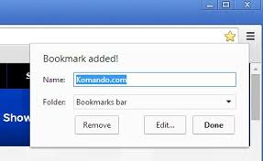
Using Bookmarks in Chrome
Save links to useful resources
Create your own custom menus
  CTRL + Shift + B to see bookmarks bar
  Click the star to add a bookmark
  Drag a link to the bookmark bar
Notes:
Might be known as “Favorites” in other browsers.
CTRL + Shift + B to see Bookmarks bar. To add a favorite click the star in the far right or drag a link to the bookmarks bar.

Slide 19

Tabbed Browsing
Allows more than one web page to open within the same browser window.
Each window appears on a separate tab
Use to organize web pages while browsing

Slide 20
References
This presentation was created by Kelly Seale of Nebo School District
www.google.com

