Slide 1
Technology Operations and Concepts
Computer Technology

Slide 2
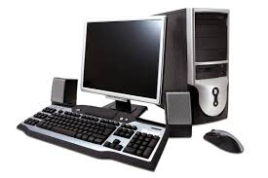
Computer Components
Hardware
Software
Notes:
Computers are made up of two basic components. Hardware and software

Slide 3
Hardware
Hardware
Monitor
Keyboard
Hard disk drive
Mouse
CPU (Central Processing Unit)
Graphic and sound cards
Motherboard and chips
Notes:
Parts of the computer you can physically touch

Slide 4
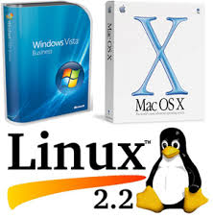
Software
System Software
Helps run the computer system
Operating System
Drivers
Servers
Examples: Windows, Linux, Mac OS
Application Software
Useful tasks
Word processing
Spreadsheets
Image Editing
Examples: Excel, Photoshop, Acrobat
Notes:
Software is programs, apps, instructions that tell the computer what to do

Slide 5
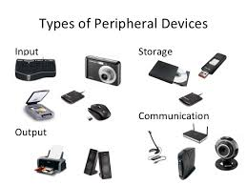
Peripheral Devices
4 main types of peripheral devices
Input Peripherals
Output Peripherals
Communication Peripherals
Storage Peripherals

Slide 6
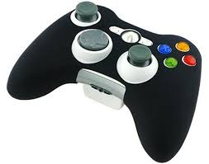
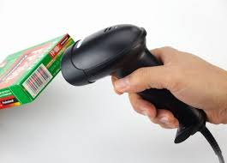
Input Peripherals
Keyboard
Mouse
Graphic tablet
Touchscreen
Barcode reader
Image scanner
Game controllers
Webcam
Notes:
In order to process information, the computer must receive data and instructions from input devices

Slide 7
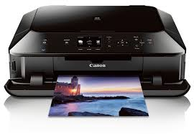
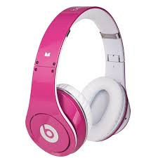
Output Peripherals
Monitor
LCD projector
Printer
Speaker
Headphones
Notes:
After information is processed, the computer must send it out through an output device

Slide 8
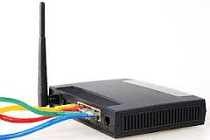
Communication Peripherals
Modems
Network adapters
Router
Wi-fi card
Notes:
These devices allow the computer to communicate with another device

Slide 9
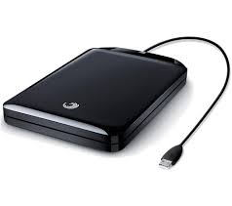
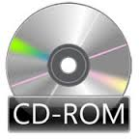
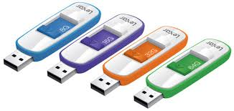
Storage Peripherals
External hard drive
Flash drive
Smartphone
CD-ROM
DVD-ROM
Notes:
Computers use other devices than the internal hard drive to store files.

Slide 10
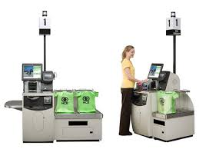
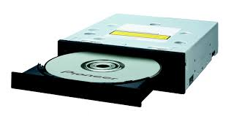
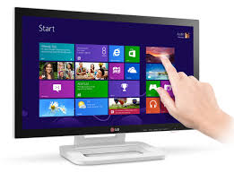
Input, Output or Both??
Self Check-out Machines
DVD/CD Burners
Touch Screen Monitors
Notes:
Some devices give input to the computer as well as show output to the user. DVD/CD Burners read and write data. Self Check-out machines at the grocery store allow users to input their information, and shows the customer their transaction. Touch screen monitors on computers, phones, etc. are used for both inputting data and outputting information.

Slide 11
Information Processing Cycle
1. Input
2.Procesing
3. Storage
4. Output
Notes:
Software and hardware work together to process data. Four basic steps in that cycle

Slide 12
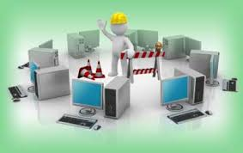
Maintaining Computer Equipment
Protect the hardware
Prevent theft
Maintain computer
Hardware troubleshooting

Slide 13
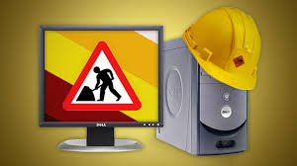
Protect Hardware from Damage
No dust or pets
Use a case for laptops
Avoid static electricity
Surge protector
Backup! Backup!
Use: flash drives, online storage, CDs, external hard drives
Prevent remote access
Use: firewalls, secure wireless access,
No file sharing programs
Use strong passwords
Avoid heat and humidity
Turn it off

Slide 14
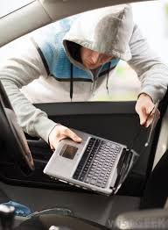
Preventing Theft
If unattended, lock the room
Lock it to another surface with a cable lock
Install an anti-theft program
Attach an alarm
Identification mark
Notes:
Anti theft programs your laptop or device’s location can be tracked when the Internet is accessed.

Slide 15
Maintain the Computer
Use Disk cleanup
Junk left behind can take up gigabytes of space
Find and destroy spyware and viruses
Uninstall unused programs
The more free space, the faster it will go!
Use Disk management systems

Slide 16
Hardware Troubleshooting
1. Power Cords
2. Outlet Power
3. Communication Connections
4. Device Configuration
5. Windows Recognition
Update Drivers
Refresh Device Manager
Blank Monitor
Power, Video Cable, Brightness/Contrast, Swap Parts, Push in Video Card
Troubleshooting

Slide 17
Selecting an Operating System
Things to consider:
Common choices:
Ease of use
Software availability
Collaboration
Multimedia
Studio work
Cost
Windows
Macintosh OS
Linux

